Slide 1
Jean Monnet Module:
Sharing Experience

Slide 2
Jean Monnet Module
Open for all HEI
Duration: 3 years, with a minimum duration of 40 teaching hours per academic year at the applicant higher education institution
Maximum grant: €30,000 (maximum 75% of the total costs)
Combination of teaching and research
https://erasmus-plus.ec.europa.eu/opportunities/opportunities-for-organisations/jean-monnet-actions/jean-monnet-modules

Slide 3
EUCP
Project summary: The project aims to develop a module on European Climate Politics at the OSCE Academy in Bishkek. It brings advanced European expertise to Central Asia, where the impact of climate change is significant and where national governments have initiated joint regional action to address it. The aim of the newly developed module is to advance European regional climate policy expertise to inform local stakeholders and policy-making. It will do this through the core course, divided into two parts, and with a series of activities aimed at the wider policy community. The project will foster dialogue between different stakeholders through workshops, including policymakers, NGOs, and academia. This knowledge-sharing will support the improvement of regional climate policies, the development of new educational programs, research initiatives and the raising of public awareness. The project will use the long-standing network of the OSCE Academy within Central Asia and beyond.

Slide 4
Our experience
Topic Selection – check the priority topics
Check existing – do you have something to build on or start from zero
Added value, what is new?
Highlight strong sides of your institution
Produce and make it available – Open access

Slide 5
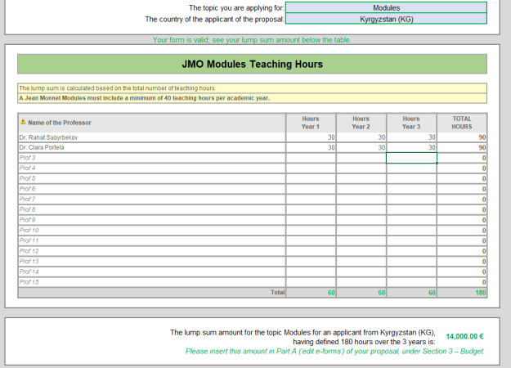
Budget

Slide 6
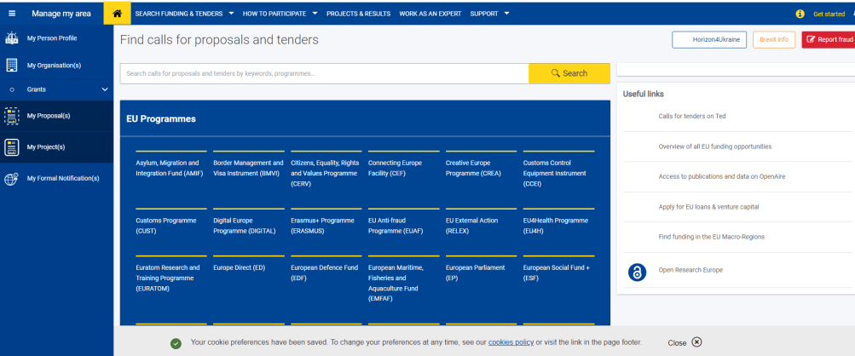
Budget

Slide 7
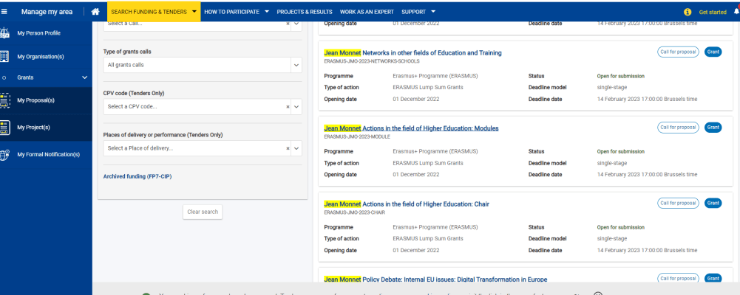

Slide 8
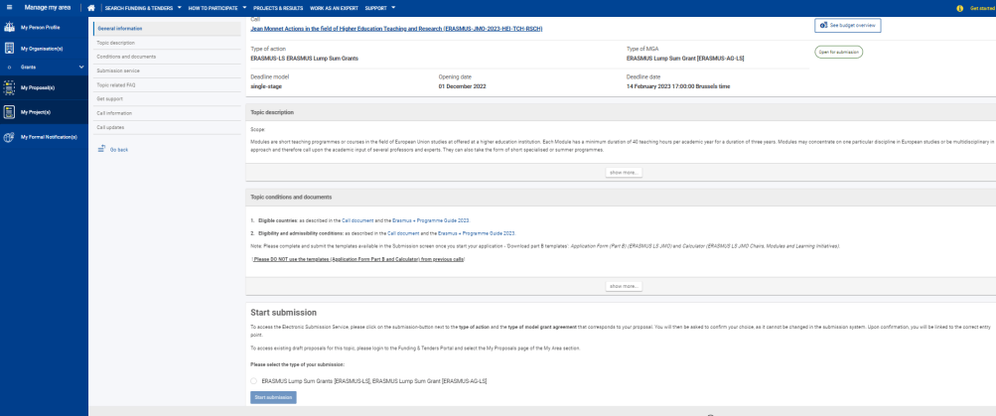

Slide 9
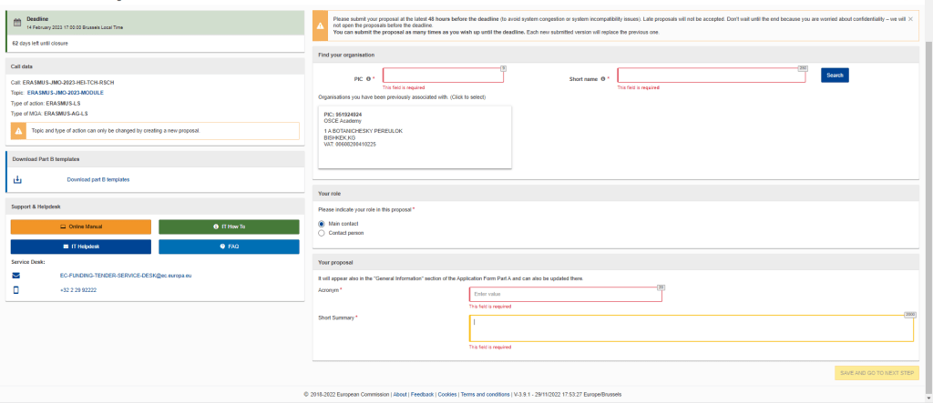

Slide 10
Thank you

